Slide 1
Start Technical Enablement Journey
Sales Accreditation on Partner Portal
Account Executive
Track
COM and HashiCorp Overview
(60m)
Technical
Track
Sales Accreditation (30m)
SE Accreditation
(3.5 hours)
Delivery Expert
Track
(next slide)
Accreditation Quiz
(15m)
SE Accreditation Quiz
(15m)
Legend
Account Mapping
Virtual session with HashiCorp SE
SE Accreditation on Partner Portal
Self-serve via Partner Portal
Learning Milestone

Slide 2
Delivery Expert Track
Can be substituted by self-paced
SE Accreditation available in Portal
Terraform 101 and Use Cases
(60m)
Vault 101 and Use Cases
(60m)
Consul 101 and Use Cases
(60m)
SE Accreditation Quiz
Terraform Associate Training
Vault Associate Prep
Consul Associate Prep
Review Certification Study Guide
learn.hashicorp.com
(Approx 16 hours)
learn.hashicorp.com
(Approx 16 hours)
Terraform Associate
Certification
Vault Associate
Certification
Also available as 3-Day Instructor led HashiCorp Academy Course
(limited first come first served spots)
Consul Associate
Certification
Terraform Enterprise Implementation Foundations
(Approx 2 Days)
Vault Ops Professional
Certification
Vault Enterprise Implementation Foundations
(Approx 2 Days)
Certified HashiCorp Implementation Partner Session
(1 Day)
1 Day Terraform CHIP Virtual Bootcamp (Registration form)
Consul Enterprise Implementation Foundations
(Beta available in Jan 2022)
Legend
Certified HashiCorp Implementation Partner Session
(1 Day)
1 Day Vault CHIP Virtual Bootcamp
(Registration form)
Virtual session with HashiCorp team
Self-serve via Partner Portal
Learning Milestone

Slide 3


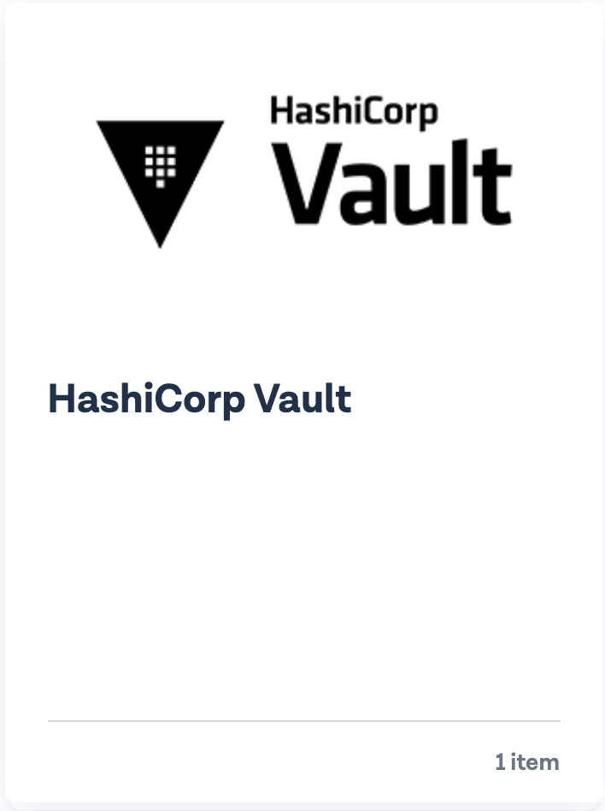
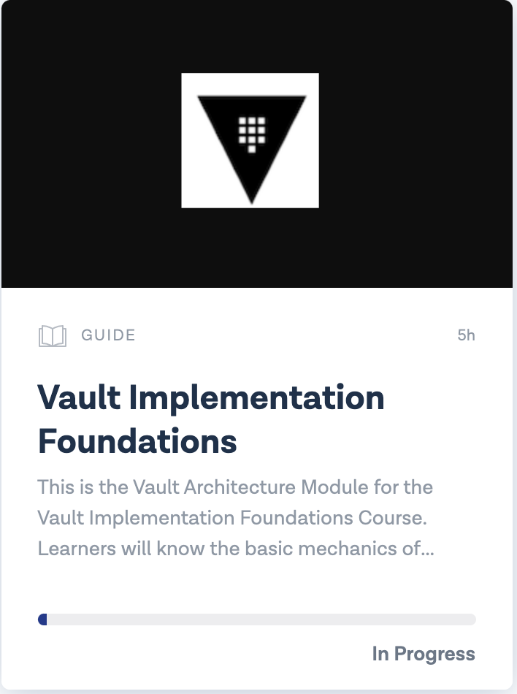
Vault Implementation Foundations
In-depth coverage of Vault architecture, configuration of common use cases and operations.
Available by logging into our Partner Portal: https://hashicorpcommunity.force.com/PartnerCommunity/s/
Getting to the course:
Click HPN Academy
Click HashiCorp Vault
Click Vault Implementation Foundations
Combination of recorded lecture videos and labs
Contact your HashiCorp Partner Manager if you do not have access
1
2
3

Slide 4
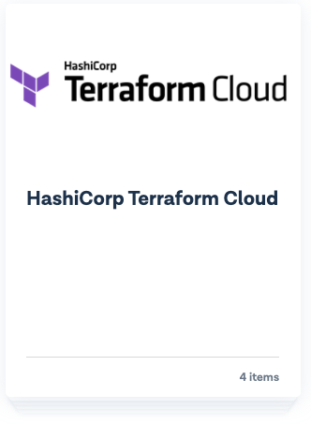
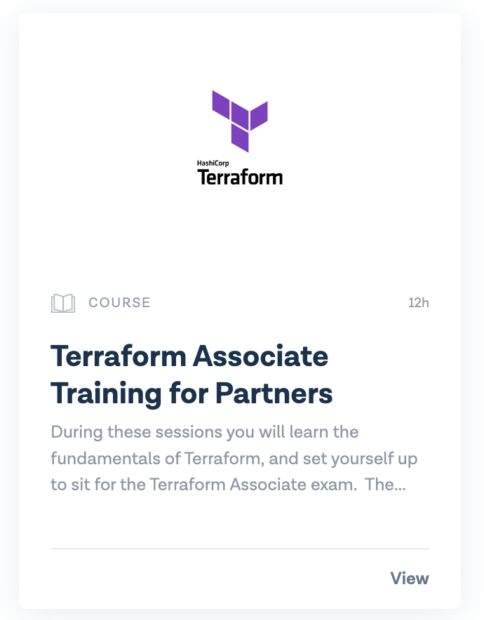
Terraform Fundamentals
In-depth foundational knowledge of Terraform. This course starts with basics and progresses to advanced Terraform constructs including expanding and testing Terraform code. In addition, the material covered in this training helps students prepare for Terraform Associate certification.
Available by logging into our Partner Portal: https://hashicorpcommunity.force.com/PartnerCommunity/s/
Getting to the course:
Click HPN Academy
Click HashiCorp Terraform Cloud
Click Terraform Associate Training for Partners
Contact your HashiCorp Partner Manager after completion for a voucher to take the exam or if you do not have access
1
2
3

Slide 5
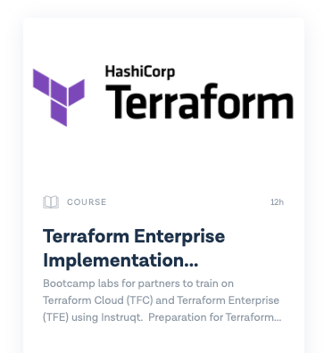
Terraform Implementation Foundations
In-depth coverage of Terraform Cloud and Enterprise features, Enterprise architecture and operations.
Available by logging into our Partner Portal: https://hashicorpcommunity.force.com/PartnerCommunity/s/
Getting to the course:
Click HPN Academy
Click HashiCorp Terraform Cloud
Click Terraform Enterprise Implementation Foundations
Combination of recorded lecture videos and labs
Contact your HashiCorp Partner Manager if you do not have access
1
2
3

Slide 6
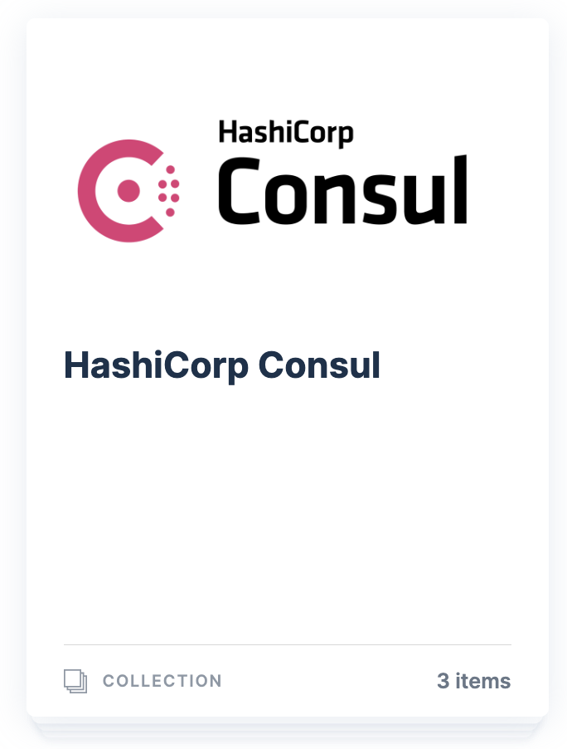
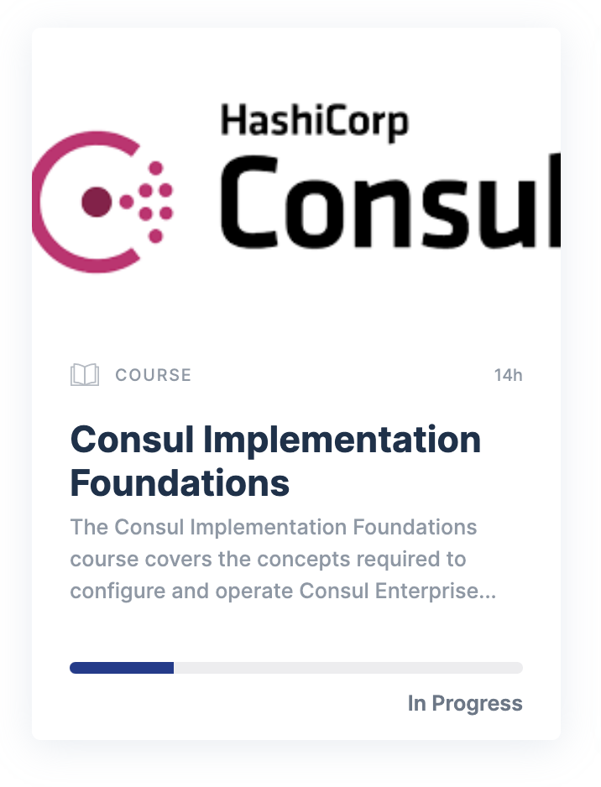
Consul Implementation Foundations
In-depth coverage of Consul architecture, configuration and operations.
Available by logging into our Partner Portal: https://hashicorpcommunity.force.com/PartnerCommunity/s/
Getting to the course:
Click HPN Academy
Click HashiCorp Consul
Consul Vault Implementation Foundations
Combination of recorded lecture videos and labs
Contact your HashiCorp Partner Manager if you do not have access
1
2
3

